Slide 1
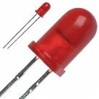
Lab 3: Blinky Lab
Blinky
Modify the blinky.asm assembly program to blink the LaunchPad red LED quickly on and off at exactly 10 second intervals.
Calculate the number of instructions and instruction cycles used by the processor during the 10 second interval.
Use these numbers to determine:
the Main System Clock frequency (MCLK),
the average number of clock cycles required by the MSP430 to execute an instruction (CPI), and
the resulting power of the processor as measured in millions of instructions per second (MIPS).

Slide 2
1. Start with blinky.asm...
Blinky
;*******************************************************************************
; CS/ECEn 124 Lab 3 - blinky.asm
;*******************************************************************************
; MCLK = _______ cycles / _______ interval = _______ Mhz
; CPI = _______ cycles/ _______ instructions = _______ Cycles/Instruction
; MIPS = MCLK / CPI / 1000000 = _______ MIPS
.cdecls C,"msp430.h" ; MSP430
COUNT .equ 0 ; delay count
;------------------------------------------------------------------------------
.text ; beginning of executable code
;------------------------------------------------------------------------------
start: mov.w #0x0280,SP ; init stack pointer
mov.w #WDTPW+WDTHOLD,&WDTCTL ; stop WDT
bis.b #0x01,&P1DIR ; set P1.0 as output
mainloop: xor.b #0x01,&P1OUT ; toggle P1.0
mov.w #COUNT,r15 ; use R15 as delay counter
delayloop: sub.w #1,r15 ; delay over?
jne delayloop ; n
jmp mainloop ; y, toggle led
;------------------------------------------------------------------------------
; Interrupt Vectors
;------------------------------------------------------------------------------
.sect ".reset" ; MSP430 RESET Vector
.word start ; start address
.end
.cdecls inserts
MSP430 symbols
into your program
.equ creates a
symbolic name
for a constant
xor.b toggles the
red LED on or off

Slide 3
Assembler Directives
Blinky
Lab 3 may require the following assembly directives:
Mnemonic and Syntax | Description
.bss symbol, size in bytes | Reserves size bytes in the uninitialized data section
.sect "section name" | Assembles into a named section
.text | Assembles into the executable code section
.byte value₁[, ..., value_{n}] | Initializes one or more bytes in current section
.word value₁[, ... , value_{n}] | Initializes one or more 16-bit integers
symbol .equ value | Equates value with symbol
symbol .set value | Equates value with symbol
.cdecls C,"filename" | Include C header in assembly code
.end | Ends program

Slide 4
Instructions You Need to Know
Blinky
Lab 3 may require the following assembly instructions:
Instruction | Description
mov.w #<value>,<register> | Replace contents of <register> with <value>
bis.b #0x01,&P1DIR | Enable LED (set pin 2 as output).
bis.b #0x01,&P1OUT bic.b #0x01,&P1OUT xor.b #0x01,&P1OUT | Turn LED on (set pin 2 high, 3.3v). Turn LED off (set pin 2 low, 0v). Toggle LED on / off.
sub.w #1,<register> | Decrement <register> by 1 and set Z status.
jne <label> jmp <label> | Jump to <label> if Z bit is 0. Jump to <label>.
call #<label> push <register> pop <register> ret | Call subroutine (place return on stack). Save <register> on stack. Restore <register> from stack. Return from subroutine (pop stack).

Slide 5
2. Add code to blink LED...
Blinky
;*******************************************************************************
; CS/ECEn 124 Lab 3 - blinky.asm
;*******************************************************************************
; MCLK = _______ cycles / _______ interval = _______ Mhz
; CPI = _______ cycles/ _______ instructions = _______ Cycles/Instruction
; MIPS = MCLK / CPI / 1000000 = _______ MIPS
.cdecls C,"msp430.h" ; MSP430
COUNT .equ 0 ; delay count
;------------------------------------------------------------------------------
.text ; beginning of executable code
;------------------------------------------------------------------------------
start: mov.w #0x0280,SP ; init stack pointer
mov.w #WDTPW+WDTHOLD,&WDTCTL ; stop WDT
bis.b #0x01,&P1DIR ; set P1.0 as output
mainloop: bis.b #0x01,&P1OUT ; turn LED on
; put some delay here...
bic.b #0x01,&P1OUT ; turn LED off
mov.w #COUNT,r15 ; use R15 as delay counter
delayloop: sub.w #1,r15 ; delay over?
jne delayloop ; n
jmp mainloop ; y, toggle led
;------------------------------------------------------------------------------
; Interrupt Vectors
;------------------------------------------------------------------------------
.sect ".reset" ; MSP430 RESET Vector
.word start ; start address
.end
Add code here to
Quickly blink LED
(Needs short delay)
Add enough instructions
Here to delay 10 seconds

Slide 6
3. Include Instruction Cycles...
Blinky
;*******************************************************************************
; CS/ECEn 124 Lab 3 - blinky.asm
;*******************************************************************************
; MCLK = _______ cycles / _______ interval = _______ Mhz
; CPI = _______ cycles/ _______ instructions = _______ Cycles/Instruction
; MIPS = MCLK / CPI / 1000000 = _______ MIPS
.cdecls C,LIST, "msp430.h“ ; MSP430
COUNT .equ 0 ; delay count
;------------------------------------------------------------------------------
.text ; beginning of executable code
;------------------------------------------------------------------------------
start: mov.w #0x0280,SP ; init stack pointer
mov.w #WDTPW+WDTHOLD,&WDTCTL ; stop WDT
bis.b #0x01,&P1DIR ; set P1.0 as output
mainloop: xor.b #0x01,&P1OUT ; toggle P1.0
mov.w #COUNT,r15 ; use R15 as delay counter
delayloop: sub.w #1,r15 ; delay over?
jne delayloop ; n
jmp mainloop ; y, toggle led
;------------------------------------------------------------------------------
; Interrupt Vectors
;------------------------------------------------------------------------------
.sect ".reset" ; MSP430 RESET Vector
.word start ; start address
.end
List cycles for each
instruction in the
comments field
(After semi-colon)
2
5
4
4
1
1
2
2
Count the number
of instructions
executed in 10 sec
interval

Slide 7
Cycles Per Instruction...
Blinky
Generally, 1 cycle per memory access:
1 cycle to fetch instruction word
+1 cycle if source is @Rn, @Rn+, or #Imm
+2 cycles if source uses indexed mode
1st to fetch base address
2nd to fetch source
Includes absolute and symbolic modes
+2 cycles if destination uses indexed mode
+1 cycle if writing destination back to memory
+1 cycle if writing to PC (R0)
Jump instructions are always 2 cycles

Slide 8
Example Cycles Per Instruction...
Instruction Clock Cycles
Example Src Dst Cycles Length
add R5,R8 Rn Rm 1 1
add @R5,R6 @Rn Rm 2 1
mov @R5+,R0 @Rn+ PC 3 1
add R5,4(R6) Rn x(Rm) 4 2
add R8,EDE Rn EDE 4 2
add R5,&EDE Rn &EDE 4 2
add #100,TAB(R8) #n x(Rm) 5 3
add &TONI,&EDE &TONI &EDE 6 3
add #1,&EDE #1 &EDE 4 2

Slide 9
4. Calculate MCLK, CPI, MIPS...
Blinky
List total number of
instruction cycles here
Calculate the Master
Clock speed:
MCLK = cycles / 10
;*******************************************************************************
; CS/ECEn 124 Lab 3 - blinky.asm
;*******************************************************************************
; MCLK = _______ cycles / _______ interval = _______ Mhz
; CPI = _______ cycles/ _______ instructions = _______ Cycles/Instruction
; MIPS = MCLK / CPI / 1000000 = _______ MIPS
.cdecls C,LIST, "msp430.h" ; MSP430
COUNT .equ 0 ; delay count
;------------------------------------------------------------------------------
.text ; beginning of executable code
;------------------------------------------------------------------------------
Calculate the average
cycles per instruction:
CPI = cycles / instructions
Finally, calculate the raw speed
of the processor (in MIPS) by
MIPS = MCLK / CPI / 1,000,000

Slide 10
Blinky Lab Requirements
Blinky
2 points Your blinky program quickly blinks the red LED on and off every 10 seconds (accurate to plus or minus 1 second per minute).
1 point The assembler directive .equ is used to define all delay counts and constants.
2 points The correct number of clock cycles for every assembly instruction is found in the comment field of each instruction.
2 points The clock speed (MCLK) of your LaunchPad processor is determined by dividing the number of instruction cycles in the timing interval (both the inner and outer loops must be used in your calculations) by the time of the interval. The speed of the processor is accurate to at least 4 significant digits. All calculations and resulting MCLK value are included in the comments at the beginning of your program.
2 points The average cycles per instruction (CPI) is determined by dividing the total number of cycles in the timing interval by the number of instructions executed in the interval. All CPI calculations and result are included in the comments at the beginning of your program.
1 point The raw speed of the processor (as measured in MIPS) is determined by dividing the processor clock frequency (MCLK) by the average cycles per instruction (CPI), divided by 1 million. All processor MIPS calculations and result are included in the comments at the beginning of your program.
+1 point A 1/10 of a second "inner" loop is programmed as a subroutine and "called" 100 times for each 10 second timing interval

Slide 11
5. BONUS: Delay subroutine...
Blinky
;*******************************************************************************
; CS/ECEn 124 Lab 3 - blinky.asm
;*******************************************************************************
; MCLK = _______ cycles / _______ interval = _______ Mhz
; CPI = _______ cycles/ _______ instructions = _______ Cycles/Instruction
; MIPS = MCLK / CPI / 1000000 = _______ MIPS
.cdecls C,"msp430.h" ; MSP430
COUNT .equ 0 ; delay count
;------------------------------------------------------------------------------
.text ; beginning of executable code
;------------------------------------------------------------------------------
start: mov.w #0x0280,SP ; init stack pointer
mov.w #WDTPW+WDTHOLD,&WDTCTL ; stop WDT
bis.b #0x01,&P1DIR ; set P1.0 as output
mainloop: bis.b #0x01,&P1OUT ; turn LED on
; put some delay here...
bic.b #0x01,&P1OUT ; turn LED off
call #myDelay
jmp mainloop ; y, toggle led
myDelay: mov.w #COUNT,r15 ; use R15 as delay counter
delayloop: sub.w #1,r15 ; delay over?
jne delayloop ; n
ret ; y, return from subroutine
Use call instruction
to "call" 1/10 second
delay subroutine. Call
subroutine 100 times.
Use ret instruction to
return from subroutine

Slide 12


Slide 13
Supplement Material

Slide 14
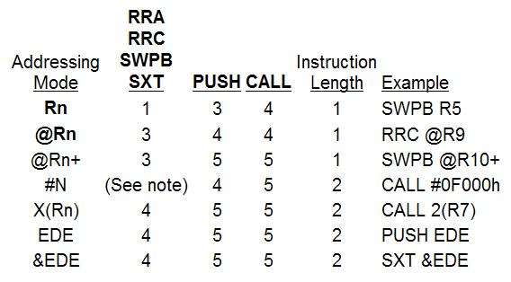
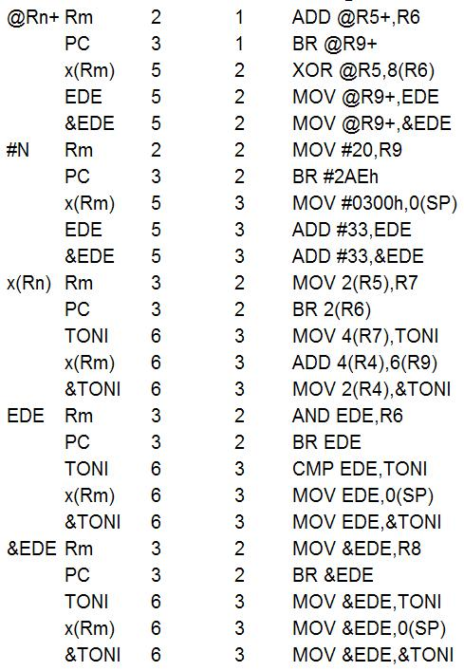
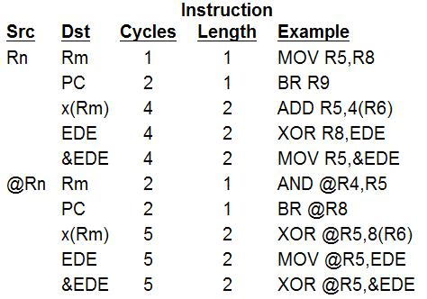
Cycles Per Instruction...
Instruction Clock Cycles
Jump instructions are always 2 cycles.

Slide 15
Assembler Coding Style
Assembler Primer
Instructions / DIRECTIVES start in column 12.
No line should exceed 80 characters.
Operands start in column 21.
Comments start in column 45.
Labels start in column 1 and are 10 characters or fewer.
;*************************************************************************
; CS/ECEn 124 Lab 1 - blinky.asm: Software Toggle P1.0
;
; Description: Toggle P1.0 by xor'ing P1.0 inside of a software loop.
;*************************************************************************
DELAY .equ 0
.cdecls C,"msp430.h" ; MSP430
.text ; beginning of executable code
start: mov.w #0x0280,SP ; init stack pointer
mov.w #WDTPW+WDTHOLD,&WDTCTL ; stop WDT
bis.b #0x01,&P1DIR ; set P1.0 as output
mainloop: xor.b #0x01,&P1OUT ; toggle P1.0
mov.w #DELAY,r15 ; use R15 as delay counter
delayloop: sub.w #1,r15 ; delay over?
jnz delayloop ; n
jmp mainloop ; y, toggle led
.sect ".reset" ; MSP430 RESET Vector
.word start ; start address
.end
Begin writing your assembly code after the ".text" directive.
The ".cdecls" directive inserts a header file into your program.
Use macros provided in the MSP430 header file.
Instructions are lower case and macros are UPPER CASE.
The ".end" directive is the last line of your program.
Assembler directives begin with a period (.)

Slide 16
Assembly Subroutines
Subroutines
Instruction | Description
call
ret
push
pop

Slide 17
CCS Breakpoints/Single Step
Blinky

Slide 18
Instructions You Need to Know
Blinky
Lab 3 may require the following assembly instructions:
Instruction | Description
mov.w #<value>,<register> | Replace contents of <register> with <value> (no status bits change).
bis.b #0x01,&P1DIR | Set pin 2 of MSPG2553 as output.
bis.b #0x01,&P1OUT | Turn LED on (set pin 2 high, 3.3v).
bic.b #0x01,&P1OUT | Turn LED off (set pin 2 low, 0v).
sub.w #1,<register> | Decrement <register> by 1 and set Z status bit to 1 if result is zero, else 0.
jne <label> | Jump to <label> if Z bit is 0.
jmp <label> | Jump to <label>.
xor.b #0x01,&P1OUT | Toggles pin 2 – turns LED off if on, and on if off.

Slide 19
Assembler Directives
Blinky
Lab 3 may require the following assembly directives:
Directive | Description
<symbol> .equ <value> <symbol> .set <value> | Create symbol
.text | Start code section
.cdecls | Include C header file
.end | End assembly process
.sect <symbol> | Start <symbol> section
<symbol> .byte <size> <symbol> .word <size>
.bss <symbol>,<size>

